Slide 1
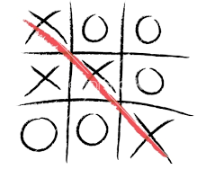
Tic Tac Toe

Slide 2

Presented by:
Rama Vikhil (20BTRCL045)
Rohit L (20BTRCL047)
Thallu chethan Aditya reddy (20BTRCL054)

Slide 3

Importing Libraries:
tkinter and messagebox
Tkinter is a commonly used library for creating GUI applications in Python for several reasons:
Built-in: Tkinter is included with most Python installations, so you don't need to install any additional packages to use it. Ut congue quis tortor eget sodales.
Lightweight: Tkinter is lightweight and efficient, making it suitable for creating basic to moderately complex GUI applications without consuming excessive system resources.
The code starts by importing the tkinter library for creating the graphical user interface (GUI) and messagebox module to display pop-up messages.

Slide 4
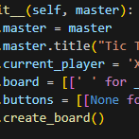
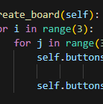
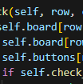
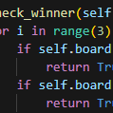
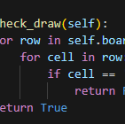
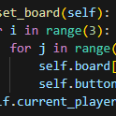
The class TicTacToe
This class encapsulates the entire Tic Tac Toe game.
Here are some reasons why creating a class for the Tic Tac Toe game is beneficial:.
Organization: By encapsulating the game logic within a class, the code becomes more organized and modular. Each method within the class represents a specific aspect of the game, such as initializing the game, handling player moves, checking for a winner, and resetting the gameMorbi a purus dolor. Suspendisse sit amet ipsum finibus justo viverra blandit.
Abstraction: The class provides an abstraction of the Tic Tac Toe game, hiding the implementation details from the rest of the program.
1
2
3
4
This defines a class TicTacToe which will represent our game. In the constructor it initializes the game's window sets its title to "Tic Tac Toe", initializes the current player to 'X', creates the game board as a 3x3 grid of spaces, and creates an empty grid of buttons . Then, it calls the create_board() method to create the graphical representation of the board.
5
6

Slide 5
def create_board(self):
def click(self, row, col):
In his method creates the game board using Tkinter buttons. It iterates over each cell of the 3x3 grid and creates a button for each cell. Each button has no text initially.
Each button is associated with a command which calls the click() method with the corresponding row and column when clicked. The buttons are then placed in the grid using the grid() method.
This method is called when a button s clicked. It first checks if the clicked cell is empty. If it is, it updates the game board with the current player's symbol ('X' or 'O') and updates the text of the clicked button accordingly.
Checks if there's a winner using the check_winner()
If there's no winner but the game is a draw check_draw()

Slide 6
reset_board Method:
def reset_board(self):
-Resets the game board and GUI to their initial state.
-Called after a game is won or drawn.
Main Block:
if __name__ == "__main__":
root = tk.Tk()
game = TicTacToe(root)
root.mainloop()
- Creates an instance of the Tk class (Tkinter main window).
- Instantiates the TicTacToe class with the root window.
- Starts the Tkinter event loop using root.mainloop().
Overall, this code creates a simple Tic Tac Toe game with a graphical user interface using Tkinter, allowing users to play by clicking on the buttons representing the game board. The game handles player turns, checks for a winner or draw, and allows for resetting the board for a new game.

Slide 7

Thank You
This Photo by Unknown Author is licensed under CC BY-NC-ND

